Slide 1
The Global, Regional, and Local Effects of the Commercial Fishing Industry
John Holowaty
Siena Heights University

Slide 2
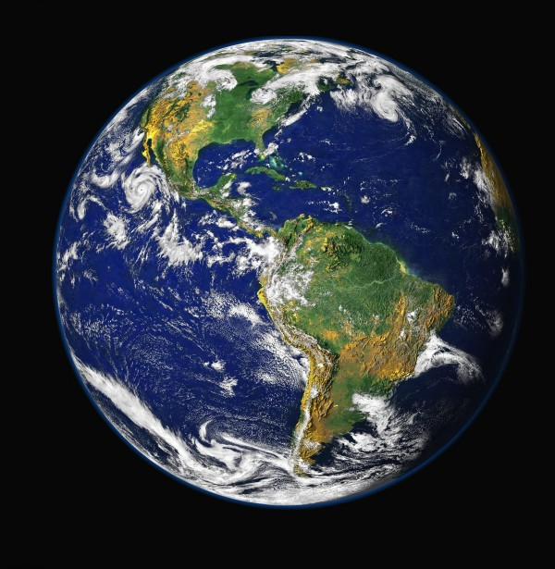
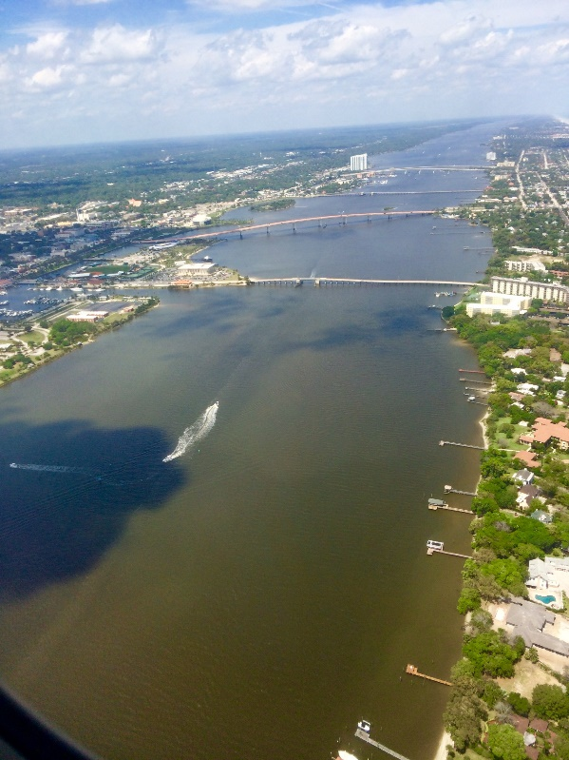
Purpose
Explore the two-way effects involved in the act of commercial fishing

Slide 3
Background
Humans have relied on the oceans for thousands of years
Commercial fishing—What is it?
Bycatch
Illegal, Unreported, Unregulated (IUU) fishing
Marine Stewardship Council (MSC)
legal-planet.org

Slide 4
Global Effects- Economics
$230 billion industry in 2014
Projected to reach $318 billion by 2022
1.7 million job in U.S alone
IUU fishing accounts for:
11-26 million tons per year
$10-24 billion annually
sites.utexas.edu

Slide 5
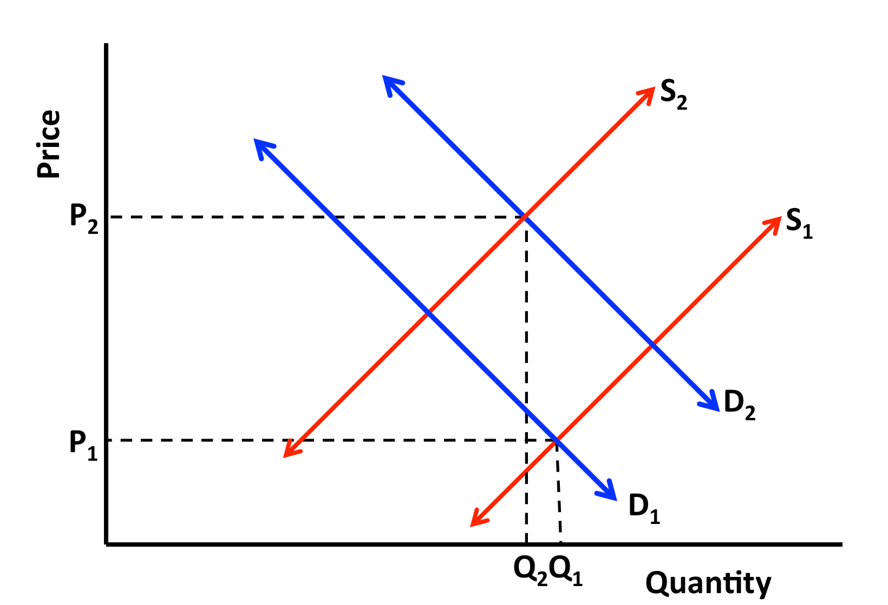
Global Effects- Overfished
29% classified as overfished
61% classified as fully exploited
Bottom of the barrel
40% of world’s fishing grounds are deeper than 200 meters
Overexploited
Demand increase; Supply decreases

Slide 6
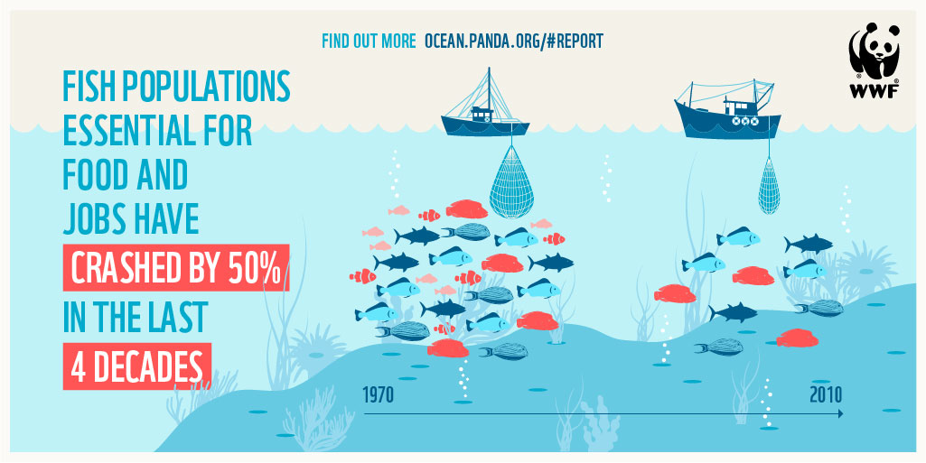
www.wwf.eu

Slide 7
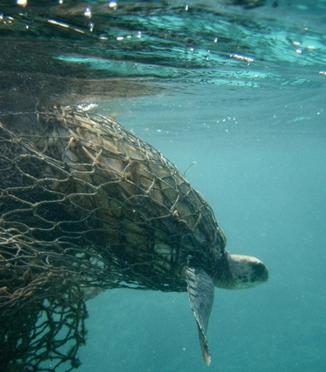
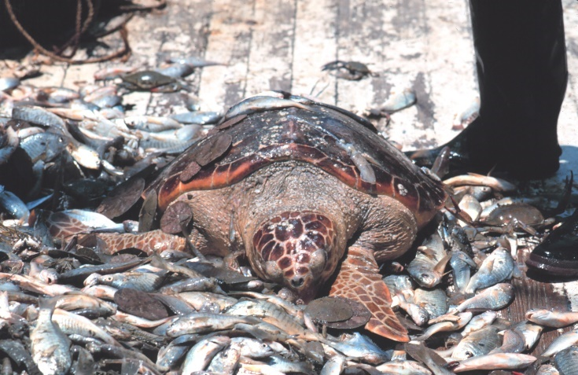
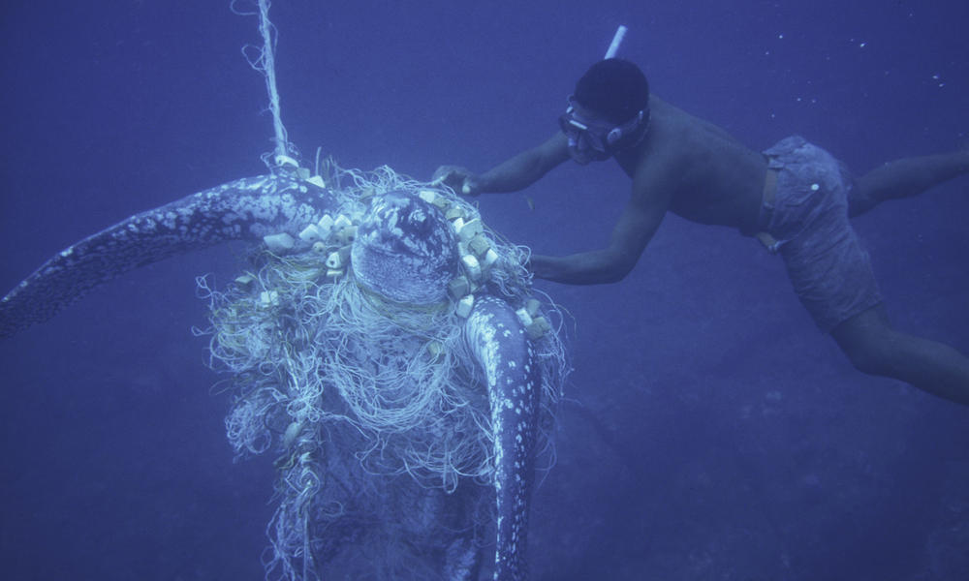
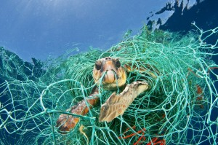
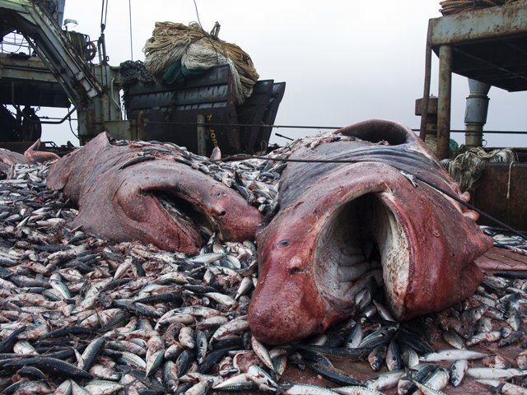
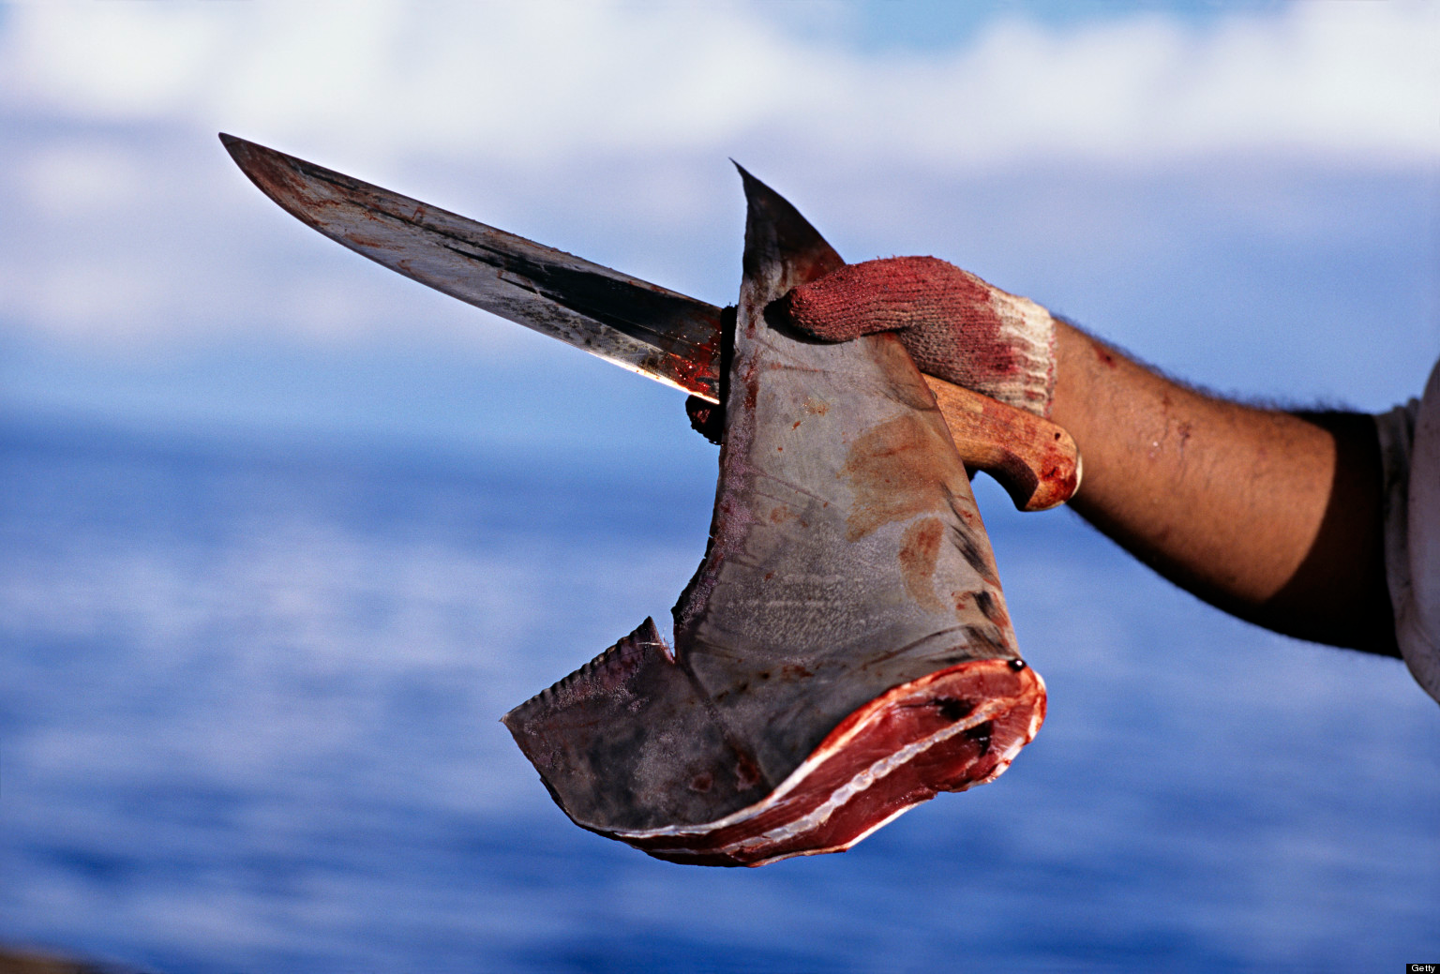
Bycatch

Slide 8
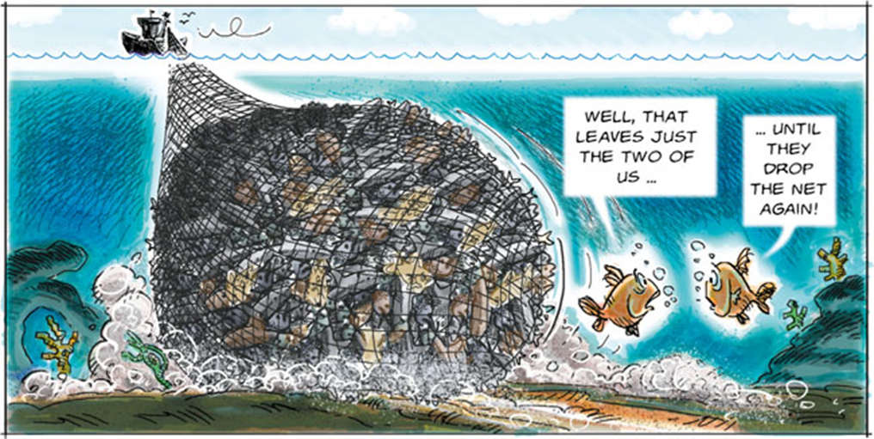
Comic Relief

Slide 9
Organizations Advocating for the Ocean
The Commission for the Conservation of Antarctic Marine Living Resources (CCAMLR)
Trying to eliminate IUU fishing
The Marine Stewardship Council (MSC)
Create a paradigm shift in global fishing industry

Slide 10
Florida
Commercial fishing license sales generated $1.7 million from taxes
Recreational freshwater fishing
$1.7 billion
14,040 jobs
Recreational saltwater fishing
$7.6 billion
109,341 jobs
0.76 bycatch ratio (B/L)

Slide 11
Indian River Lagoon
Generates upwards of $3.7 billion per year
Supports 15,000 full and part-time jobs
Generates recreational opportunities for over 11 million people per year
Responsible for about 12.2% of fishing jobs in Florida
Credit: Jared Kimmitt

Slide 12
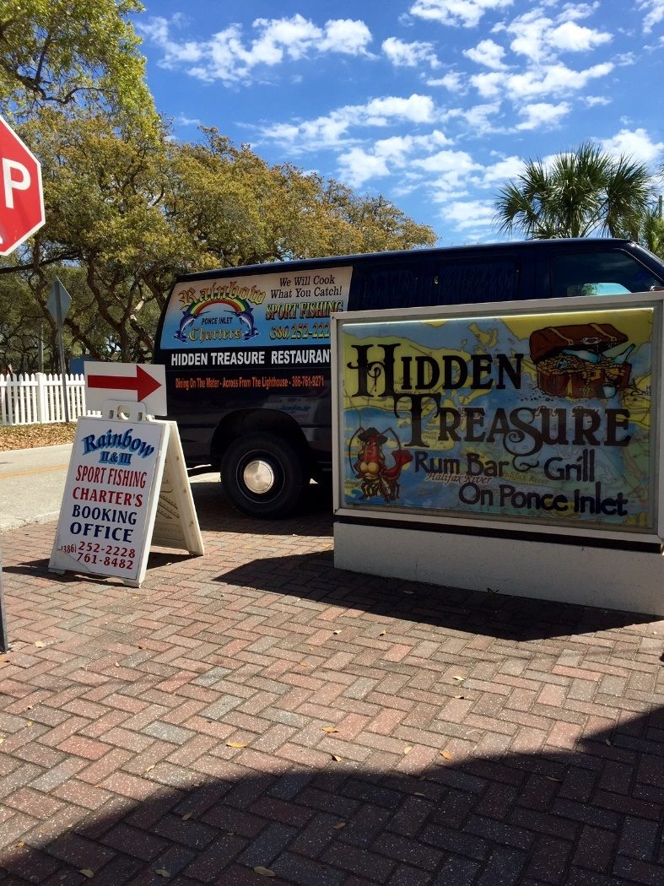
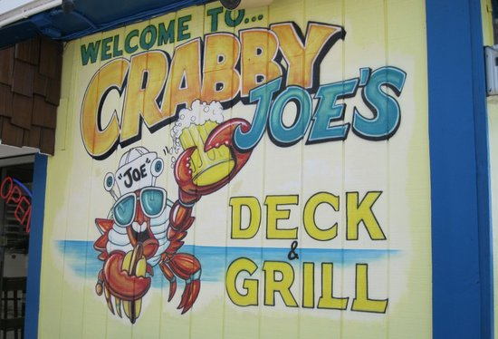
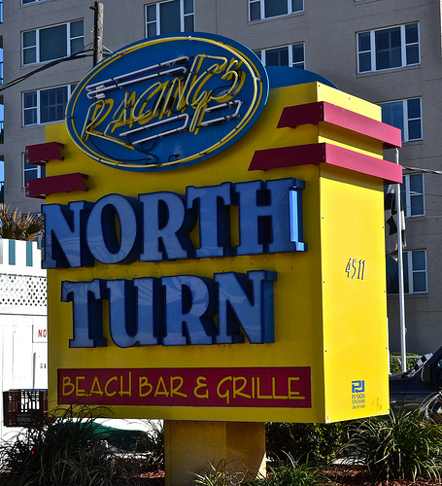
Ponce Inlet/Daytona Beach

Slide 13
Menu Notes

Slide 14
Questions?

Slide 15
Sources
"Overfishing." WorldWildlife.org. World Wildlife Fund. Web. 09 Mar. 2016.
"The Economic Impact of Saltwater Fishing in Florida." Value of Saltwater Fishing in Florida. Web. 22 Mar. 2016. <http://myfwc.com/conservation/value/saltwater-fishing/>.
"The Indian River Lagoon: An Estuary of National Significance." News Releases. Web. 10 Mar. 2016.
"What We Do." —. Web. 22 Mar. 2016. <https://www.msc.org/about-us/what-we-do>.
Bradley, Richard. "Lagooner." Indian River Lagoon, Florida's Intracoastal Waterway IRL. 19 Jan. 2016. Web. 22 Mar. 2016. <http://indian-river.lagooner.com/>.
Brooke, Samantha G., Lisa L. Desfosse, William A. Karp. “Estimating Overall Fish Bycatch in U.S Commercial Fisheries.” Marine Fisheries Review 74.3 (2012): 1-5.
Census of Marine Life. "How Many Fish In The Sea? Census of Marine Life Launches First Report." ScienceDaily. ScienceDaily, 24 October 2003.
Jha, Alok. "Eat More Anchovies, Herring and Sardines to save the Ocean's Fish Stocks." The Guardian. Guardian News and Media, 18 Feb. 2011. Web. 22 Mar. 2016.
Österblom, Henrik, and Örjan Bodin. "Global Cooperation among Diverse Organizations to Reduce Illegal Fishing in the Southern Ocean." Conservation Biology 26.4 (2012): 638-48. Web.
Raby, Graham D., Alison H. Colotelo, Steven J. Cooke, and Gabriel Blouin-Demers. "Freshwater Commercial Bycatch: An Understated Conservation Problem." BioScience 61.4 (2011): 271-279. Web.
Reddy, Niha. "Global Commercial Fishing Industry Market Outlook (2015-2022)." 9 Dec. 2015. Web.
"102." 102. Web. 22 Mar. 2016. <http://www.nmfs.noaa.gov/sfa/sfaguide/102.htm>.
"2010-2015: New Horizons." —. Web. 22 Mar. 2016. <https://www.msc.org/about-us/our-history/2010-2015-new-horizons>.
"Economics." FWC-. Web. 10 Mar. 2016. <http://www.myfwc.com/about/overview/economics/>.
"Florida's Top 10 List of Fish." | VisitFlorida.com. Web. 22 Mar. 2016. <http://www.visitflorida.com/en-us/fishing/articles/fishing-capital/kingmackereltomalin051614.html>.
"Indian River Lagoon - Spacecoast Business Magazine." Spacecoast Business Magazine RSS. 2014. Web. 10 Mar. 2016.
"Living Blue Planet Report 2015." WorldWildlife.org. World Wildlife Fund, 2015. Web. 10 Mar. 2016.

